Slide 1
Wearables:
The past, present and future of technology, people and the planet
Dr Rachel Kavanagh & Dr Hugh Manning
Education and Communications Office, AMBER
Notes:
3 mins

Slide 2
Learning Intensions
Sustainability and Wearables
Wearables: past, present & future
Ireland 2050: A more connected world - what implications for society?
Sustainability & Wearables: looking for balance
Where in the world will our wearables come from?
Scientists & sustainability
Notes:
3 mins Learning Intentions
The workshop is broken into 6 activities
Setting a context - Sustanability and wearables – some definitions.
What is a wearable? Does everyone have their mobile phones? In this activity we will get some ideas from you about your perceptions of ‘wearable’
Wearables: past, present & future: In this activity we’ll use images and information to identify some key trends relating to wearables
Ireland 2050: A more connected world - what implications for society? This activity really gets your to critically reflect on the implications of wearables for society.
Sustainability & Wearables: in this I’ll build on the rest of the workshop to talk through where sustainability and wearables collide so that we have a common framework to analyse Where in the world will our wearables come from? Which is the core activity of the workshop
In the last activity I’ll give you a sense of where AMBER (where I work!) and the scientists that I work with are trying to contribute to the future of wearable devices & sustainability
Booklet – the outline and materials you need to do the activities are all in your booklet.
But to start with – its over to you – what is a wearable?

Slide 3
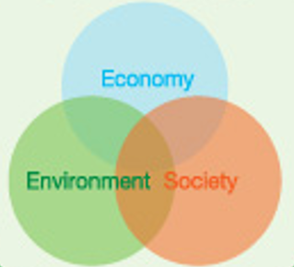
What is sustainability?
Sustainability focuses on meeting the needs of the present without compromising the ability of future generations to meet their needs.
The concept of sustainability is composed of 3 pillars: economic, environmental and social - also known informally as profits, planet and people.
But these 3 pillars exist over time and space: local to global
Brudtland Commission, Our Common Future, 1987
Notes:
Setting a context – we’re going to investigate sustainability through the development of technology – in particular wearables.

Slide 4
Wearables: past, present and future
Purpose: To examine societies relationship with ‘wearables’ through time.
Teams – you will be given a set of 15 cards
  Look at each image and read the associated text
  Create a timeline with your cards.
  Each group will feedback with a suggested end date (how far into the future?) for your timeline.
  Under the clock: 5 minutes
  Follow up: Whole group discussion
Notes:
6 mins for reviewing cards and coming up with trends.
4 mins for discussion
In booklet

Slide 5
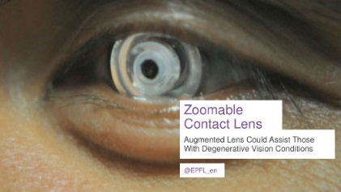
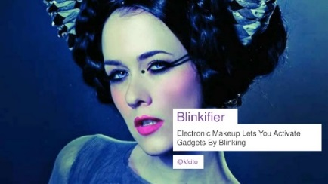
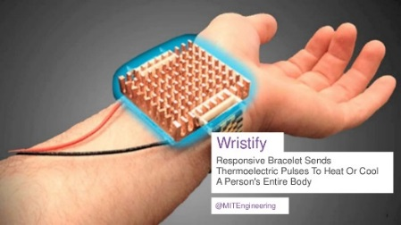
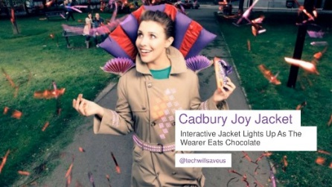
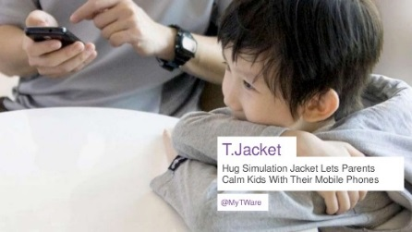
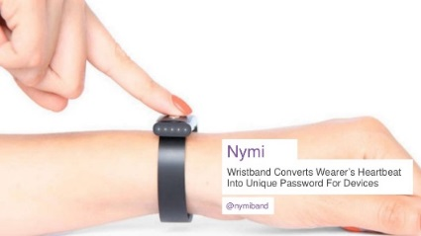
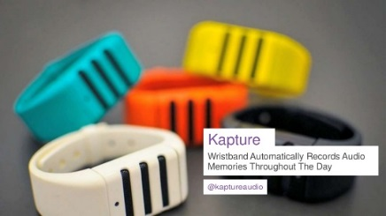
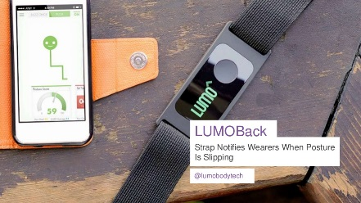
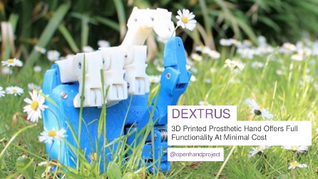

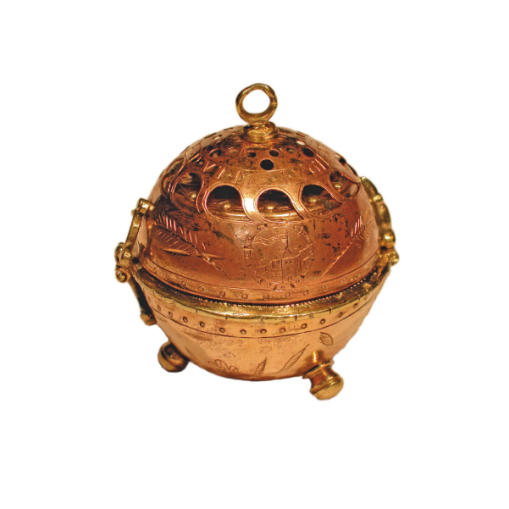
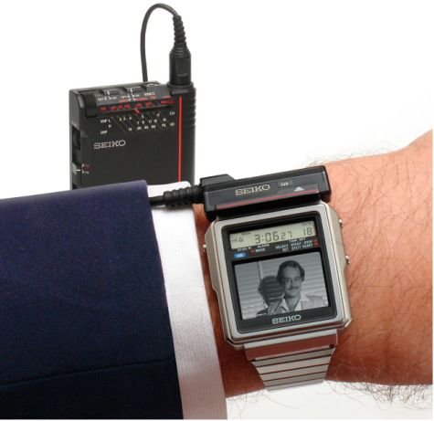
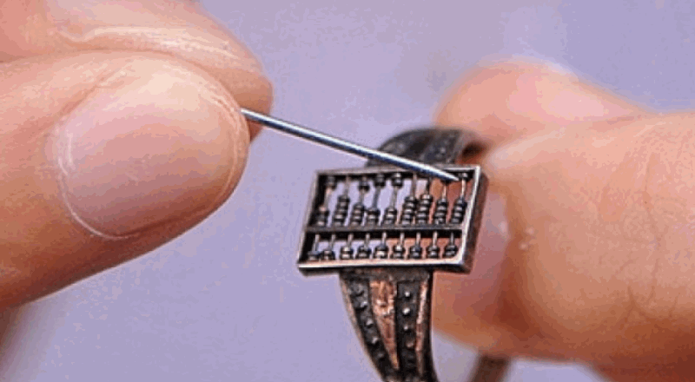
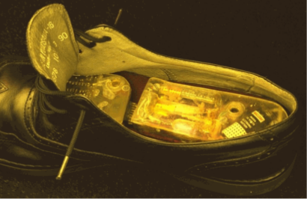
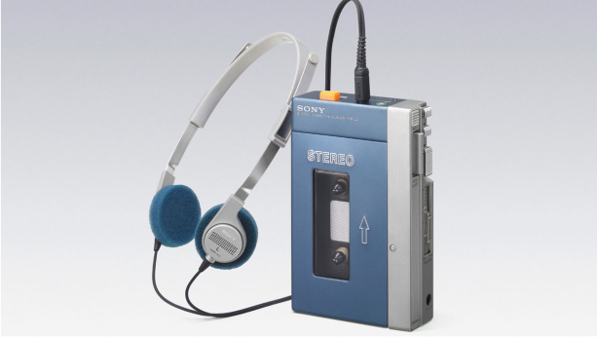
Wearables: past, present and future
All of these wearable technologies are either prototypes or art projects
What can wearable devices from the past tell us about how society engages
with technology?

Slide 6
Wearables: past, present and future
  Technology can transition from elite to mainstream overtime
  Some wearables change in form over time e.g. watch
  Some are integrated once new technology becomes available (e.g. Walkman and TV watch)
  Wearables… to wearable technology
    1960’s: introduction of electronics into wearables

Slide 7


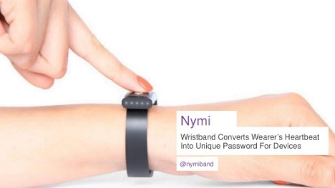







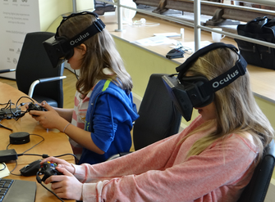

Ireland 2050: A more connected world What implications for society and education?
By 2020 the Internet of Things (IoT) is envisioned to have over 20 billion connected objects
Significant economic growth forecast:
The global wearable device market is to grow from $24.8 billion in 2017 to more than $67 billion by 2024
What do you think about the growth in wearable technology?
What positive and negative implications for society?

Slide 8
Sustainability & Wearables:
looking for balance
What implications for Economy?
Forecast growth from $24.8 billion in 2017 to more than $67 billion in 2024
What implications for Society?
Complex impacts on present & future generations
What implications for Environment?
What implications for people and places on other part of the globe?
  Sustainability: often represented as equal spheres of economy, society & environment. Reality?
Notes:
10 mins Rationale: Interactions. Sustainability. Collision of three. Same size but in reality. Economy is much bigger.
Lets look at where we are currently regarding the relationship between technology and environment through just one device that we all have and use – the smartphone.

Slide 9
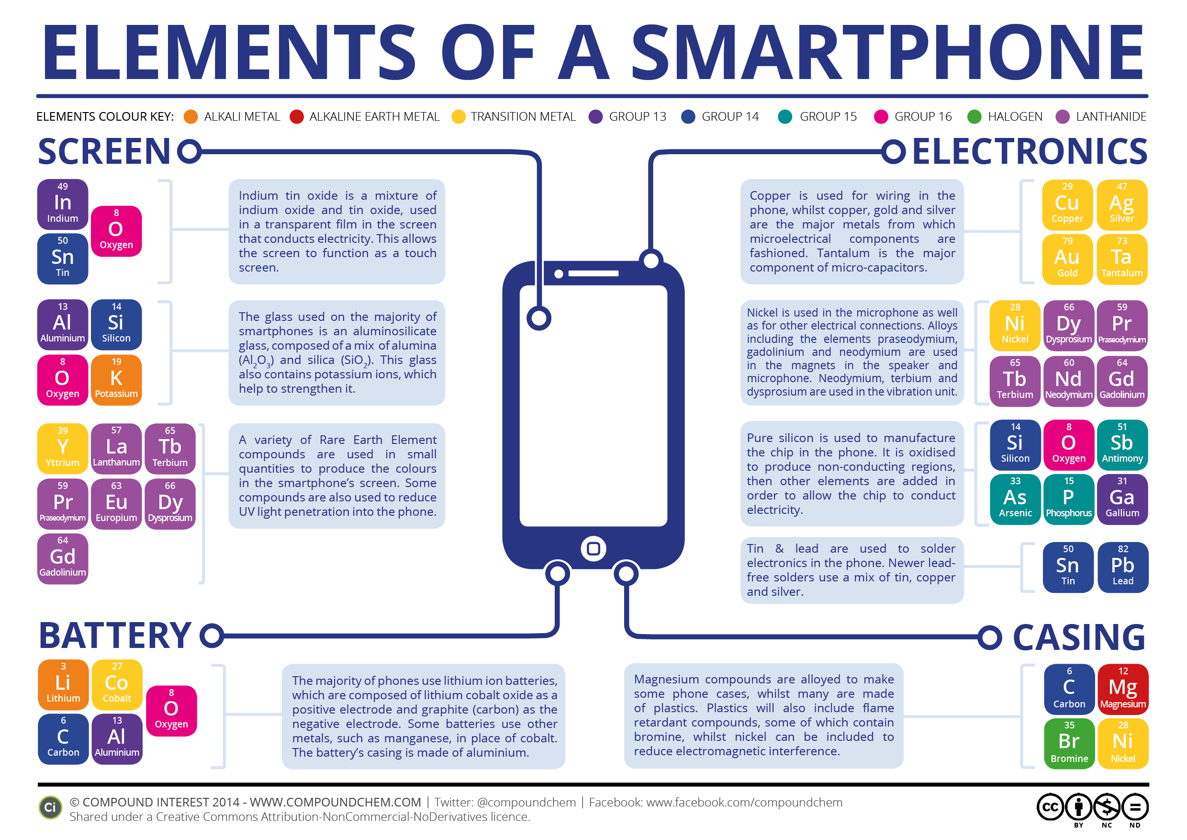
Notes:
Rationale: massive use of resources

Slide 10
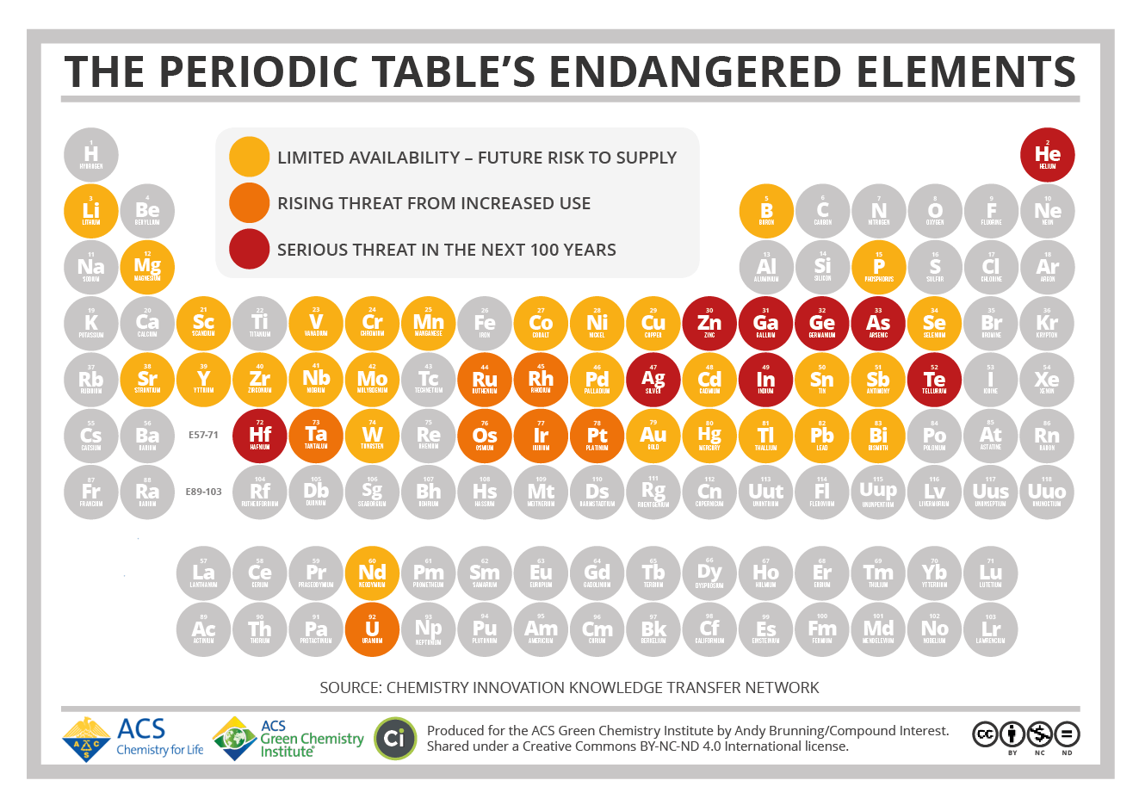
Notes:
Rationale: Endangered resources

Slide 11
Screen
Notes:
Rationale: Links between endangered and mobile phone screen. Require screen and energy to run them. What impact will it have on the enviornment

Slide 12
Electronics
Notes:
Rationale: Links between endangered and mobile phone screen. Require screen and energy to run them. What impact will it have on the enviornment

Slide 13
Battery
Notes:
Rationale: Links between endangered and mobile phone screen. Require screen and energy to run them. What impact will it have on the enviornment

Slide 14
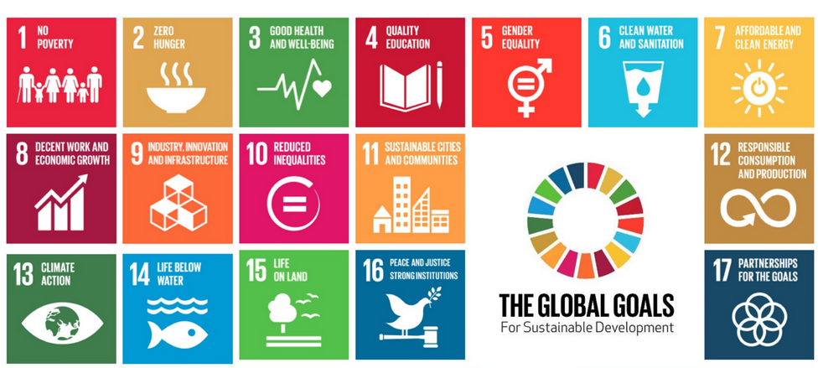
Sustainability & Wearables:
looking for balance
Goal 17: “A successful sustainable development agenda requires partnerships between governments, the private sector and civil society.”
Notes:
To put this idea of governance is central to how we manage ourselves (as a society) and the environment, and economic growth – it relates primarily to goal no 17
What we are going to do in the next activity is explore some of the other goals that sometimes might seem more challenging to relate to the idea of sustainability.

Slide 15
Where in the world will our wearables come from?
Case study of cobalt (Co)
Where does Co come from?
Could it be managed more sustainably?

Slide 16
Exploring where the cobalt comes from:
Travel to where Cobalt comes from – the Democratic Republic of Congo using Google Earth
https://earth.google.com/earth/d/1IvhWiR2AHfRKODDPN2bNewcTMWhM8NCS?usp=sharingo
Introduce some facts about the Congo
Hand out the following slides so that students become familiar with the country.

Slide 17
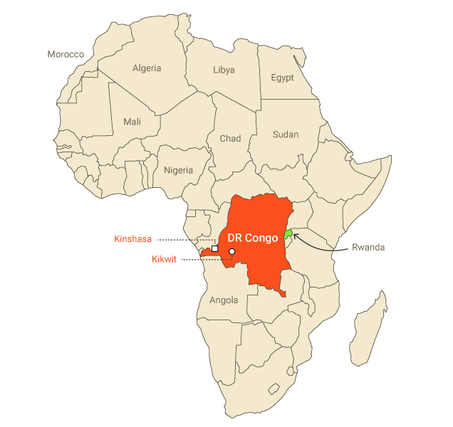
The Democratic Republic of the Congo (DRC) is located in central Africa and has a population of 77 million
DRC has a rich source of many minerals that people use across the world. The region has an estimated $24 trillion in untapped minerals
The DRC has the potential to become one of the richest countries on the continent of Africa
What questions do these facts raise?
DRC ranks among the poorest countries in the world at 176 out of 187 countries on the most recent Human Development Index calculated by the UN (2015)
Notes:
Following Images in Booklet

Slide 18
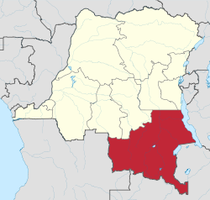
Where in the world will our wearables come from?
Katanga province (Marked in red on the map) is in the South of the DRC. Cobalt and other minerals are mined from this province today
Notes:
Following Images in Booklet

Slide 19
Exploring where the cobalt comes from:
Hand out the news article:
https://www.theguardian.com/global-development/2018/oct/12/phone-misery-children-congo-cobalt-mines-drc
What questions did the piece pose about economics, society and environment?
How can we think critically about the pieces?
What voices/ organisations were represented?
What voices/ organisations were not represented?

Slide 20
Is the our use of cobalt and other resources sustainable?
Sustainability focuses on meeting the needs of the present without compromising the ability of future generations to meet their needs.
The concept of sustainability is composed of 3 pillars: economic, environmental and social - also known informally as profits, planet and people.
But these 3 pillars exist over time and space: local to global
Brudtland Commission, Our Common Future, 1987
Notes:
Setting a context – we’re going to investigate sustainability through the development of technology – in particular wearables.

Slide 21
What is AMBER and what do we do?
Can science contribute to sustainability?
What is each scientist going that could help people and the environment?
Notes:
Material scientists investigate the structure, properties and process through which of materials are formed

Slide 22
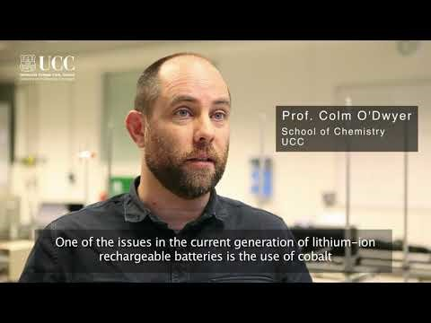
Notes:
https://youtu.be/ZLgryqaT83k
https://www.youtube.com/watch?v=8NS3kpAml2A

Slide 23
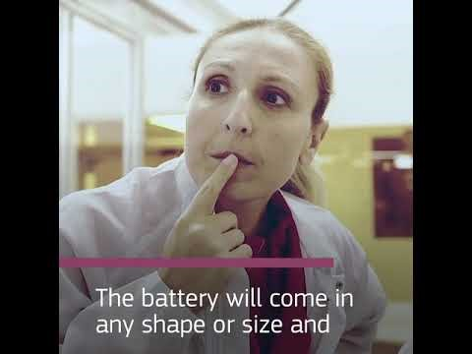

Slide 24
How are AMBER scientists contributing to sustainability?
What would you do if you were a researcher?

Slide 25
Contact us!
www.ambercentre.ie
@ambercentre (twitter)
Notes:
3 mins

